Slide 1
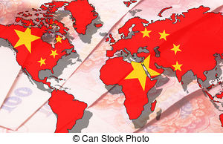

Internationalization of the RMB
A.Purevsuren GDW2017202

Slide 2
Contents
International currency criteria
RMB achievements
Challenges
Why…. comment
Conclusion and Reference

Slide 3
International currency criteria
Global Trade currency
Global Investment currency
Fully convertible currency
Global Reserve currency

Slide 4
RMB as global trade currency
2009. July
2010.June
2008
2016.Sep
Cross border +3
All countries
135 economies' 3.3tn
Pilot Project
Pilot Project
Currency swap
USA+20
Clearing Center
Notes:
Shanghai as a global financial hub and added new offshore clearing centers in Switzerland, Australia, Canada and, notably for the U.S. market, a RMB clearing bank was designated in the U.S. in September 2016.

Slide 5
RMB as Global Investment currency
RMB as Investment currency
2016.Feb
2007
China Interbank Bond Market was liberalized to allow for foreign institutional investors to access the bonds traded onshore in China, bolstering RMB’s depth as an investment currency
2011
10 Din Sum Bond in HK
2010
Jan 2011: Pilot RMB settlement of ODI launched.
Oct 2011: RMB FDI was introduced by MofCom and PBoC.
Pilot scheme for eligible offshore financial institutions to invest in domestic inter-bank bond market.

Slide 6
RMB as reserve currency
2016.Oct.01
2015.Nov.30
RMB became the fifth currency in the International Monetary Fund’s (IMF) Special Drawing Rights (SDR) basket, joining the ranks of official reserve currencies..
Non date
International Monetary Fund (IMF) approved the inclusion of the RMB in its Special Drawing Rights (SDR) basket of currencies
It was reported that Malaysia and Nigeria hold RMB bonds as
a part of its foreign reserves.

Slide 7
Top hints
4th Most used currency- 2% of transaction
B
1.98% of World trade-30% of its trade
A
C
10.92% SDR Basket composition
3rd most SDR basket
RMB
E
D
Foreign exchange market 4% of turnover
$130 Billion Dim Sun bond

Slide 8
Strong RMB
Peg
Inflow
Consump
-tion
International
Reserve
Notes:
Why? Get out from trap
GDP growth eco growth was just FDI flow and labor intensive industries
Production and growth: How about capital growth Y=A*F(Labor, Physical Capital, Human Capital, Natural resource)
Eco still depends on export oriented
Cheap goods export
High Inflation import

Slide 9
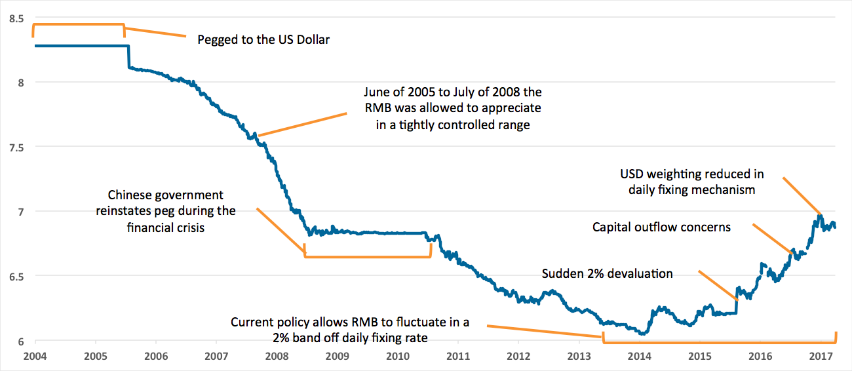
Well pegged RMB
Notes:
RMB pegged so well

Slide 10
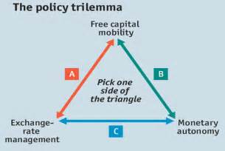

Monetary policy analysis
Notes:
Triangle became scalene triangle bc china put so much effort in exchange rate pegging

Slide 11
Inflation cause
Cause
Inflation In China
External- Hot flow of foreign money asks PBOC print more.
Cost-push
Internal – Less domestic consumption results save more and more.
Cost-push
Notes:
M2- 9.4%increase GDP 6.9%increase 2017

Slide 12
Inflation digestion
Hot money
Consumption
Inflation
Bills and Bond
Government
Loss
Credit risk
Currency risk
Notes:
Can’t digest all liquidity, end up inflation go through real state
Real economic growth or money makes money through financial institution Central banks can control everything but rate of deposit and loan??
2008 crises CPI reaches 25%
NPL increase if interest rate changes some 40% NPL
Untill 2008 +60B so far -40B

Slide 13
On balance
Economic growth
Internationalism
OBOR
SDR
RS
Independent monetary policy
Injection
Go Global
Import more
Innovation
Inflation
Social safety
Notes:
GDP growth eco growth was just FDI flow and labor intensive industries
Production and growth: How about capital growth Y=A*F(Labor, Physical Capital, Human Capital, Natural resource)

Slide 14
Challenge
Rule by law
Inflation
RMB
Real economy
support
Notes:
China in just the 44th percentile for the rule of law (World Bank, 2016), while Transparency International places China 79th out of 176 nations in its corruption perceptions index (Transparency International, 2017).

Slide 15
Comment..Why?
International
RMB
Liquidity
Power
Velocity
Value
Notes:
Convenient = cost less transaction as a largest export, benefit of international money , does not want usa collapse they are good consumer
Value of reserve = they lost usa bond 40$b
Velocity= support money circulation less domestic consumption
Liquidity= spread through world PBC control it by 3 engines: RRR not so effective just freezing
: interest rate –default Open market needs…

Slide 16
Conclusion
Independent
Monetary
Policy
Capital
account
Fully
convertible
currency
Notes:
GDP growth eco growth was just FDI flow and labor intensive industries
Production and growth: How about capital growth Y=A*F(Labor, Physical Capital, Human Capital, Natural resource)
Eco still depends on export orianted
Underdeveloped bond market
– Regulated exchange rate and interest rates

Slide 17
References
Sun Guogeng, and Li Wenzhe. 2017. “Monetary Policy, Exchange rate and Capital flow.“ The People’s Bank of China Working Paper series:2017/3.
Hilary Love, and Chris Chen. “Chinese renminbi Internationalization guide to recent developments ” PNC International Services
Caroline Owen 2017. ”RMB global”. Special Bloomberg evolution.
Benjamin J. Cohen. “Renminbi Internationalization: A Conflict of Statecrafts”. International Economics Department
https://www.thebalance.com
https://www.wikipedia.com
https://www.tradingeconomics.com
https://www.stratfor.com
https://www.pboc.com annual report

Slide 18
Thank You !

